Slide 1

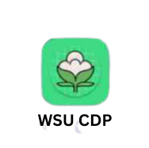
Thesis presentation
Developing a Deep Learning-Based System for Real-Time Cotton Disease Prediction with Integration of Web and Android Applications for Field Diagnosis
Submitted By: ID
Ehitnesh Chikelu ..............................................................Eng/R/637 /11
Getachew Birlew…............................................................Eng/R/378/11
Matiwos Desalegn.............................................................Eng/R/109/11
Tsegaw Molla.................................................................Eng/Rt/1073/12
Advisor: Mr. Guyita(Msc) Submission Date: 7/10/2015 E.C

Slide 2
Presentation Outline
Introduction
Statement of the Problem
Objectives
Literature Review
Methodology
System Design
Results and Discussion
Conclusions
Future Directions
1

Slide 3
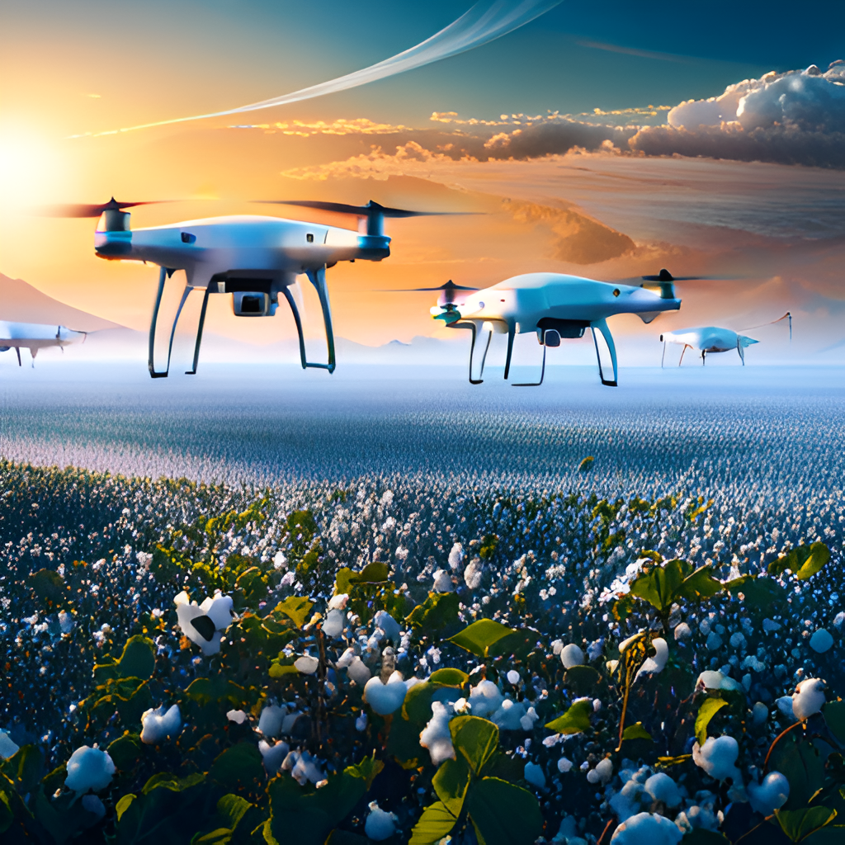
Introduction
Cotton is a vital crop, but disease prediction and prevention pose challenges for farmers.
Deep learning technology has emerged as a powerful tool for predicting cotton diseases, offering potential improvements to agriculture.
The integrated web application, coupled with an informative web page and Android application offers practical tools for farmers, empowering them to make informed decisions and proactively manage diseases in their crops.
2

Slide 4
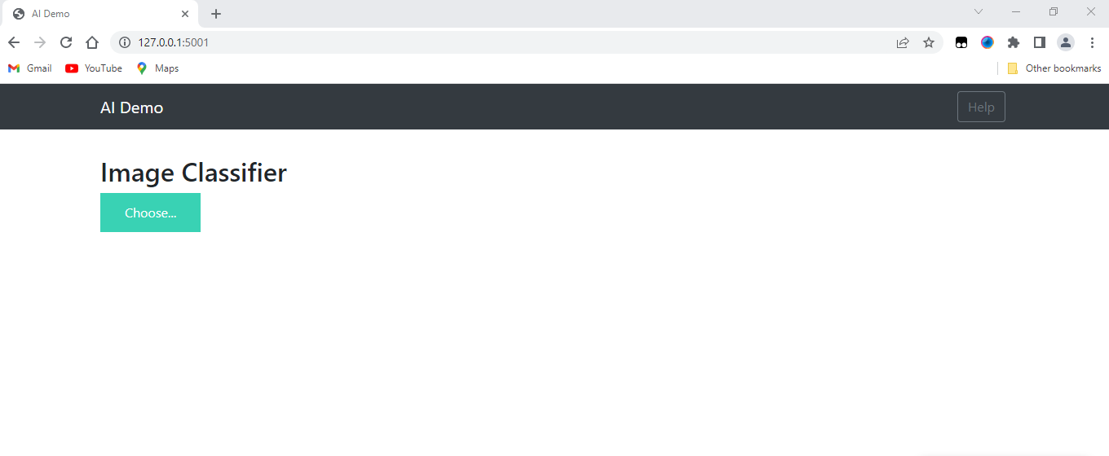
Statement of the Problem
While the Previous works made significant progress in distinguishing between fresh and diseased categories, there are certain limitations that need to be addressed in the upgrade. The upgraded project will focus on the following enhancements:
User Interface: The Previous interface lacks interactivity and intuitiveness, limiting user experience and usability.
The deep learning model is not integrated with an Android application,
Preventing it from real-time image processing and instant predictions in the field.
Lack of Project and Cotton Information
3

Slide 5
Objectives
To develop a comprehensive cotton disease prediction system using deep learning techniques and integrate it into a user-friendly web application, with an interactive web page, and an Android application.
The system aims to provide automatic real-time field diagnosis of cotton plants and leaves for predicting their freshness or disease status.
Convert our trained model to TensorFlow Lite format for easy deployment on mobile devices and develop an Android app using Java that can take pictures of cotton plants and get predictions using TensorFlow Lite.
Test our web page and Android app to ensure functionality and accuracy and evaluate the performance of the model.
4

Slide 6
Literature Review
The Challenges in Cotton farming are a complex and challenging process that requires careful monitoring and management.
One of the biggest challenges that cotton farmers face is predicting and preventing diseases.
Cotton diseases can cause significant yield losses and reduce the quality of the cotton produced.
According to recent studies, cotton farmers lose an estimated $1 billion each year due to diseases.
The previous works aimed to utilize deep learning techniques,
And predicts whether a cotton plant or leaf is fresh or diseased through a web application Using using Flask and hosting it on a WSGI server
To provide a user interface for the model that allows users to upload images and receive predictions of whether they are fresh or diseased.
5

Slide 7
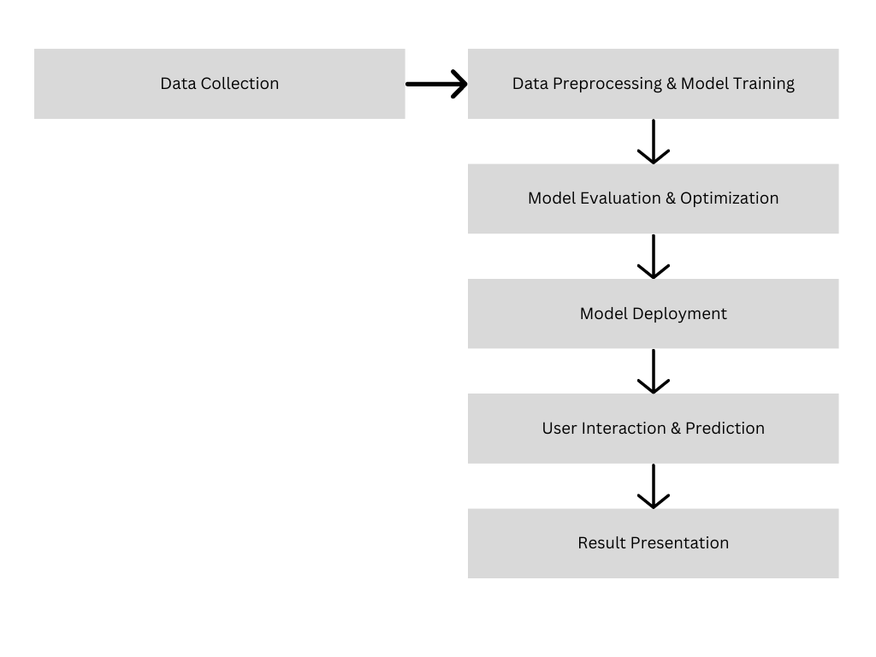
Methodology
Preprocess and augment cotton plant and leaf image dataset for deep learning training.
Train a CNN model using transfer learning with a pre-trained ResNet152V2 model on a fresh/diseased labeled dataset.
Build a Flask web application for a user-friendly interface.
Host the web application on a WSGI server for scalability and reliability.
Use Anaconda Environment and Jupyter Notebook for model building and training.
Use Spyder as an IDE for running Flask web applications.
Developing an Interactive Web Page with Bootstrap
Mobile Android Application Integration with TensorFlow Lite
Testing Functionality and Accuracy

Slide 8
System Design
Improved User Interface: Enhance the website's design and layout, making it visually appealing and user-friendly.
Include an about section highlighting the AI-based cotton disease prediction project, contact information, and a link to the GitHub repository.
Utilize technologies like deep learning, Keras, Flask, Python, HTML, CSS, JavaScript, AJAX, and Bootstrap.
Additionally, a prominent button or link will be added to access and run the disease prediction application.
Integrate the model with an Android app for on-the-field image capture, processing, and instant disease predictions.
The app is a lightweight, and capable of offline usage.
7

Slide 9
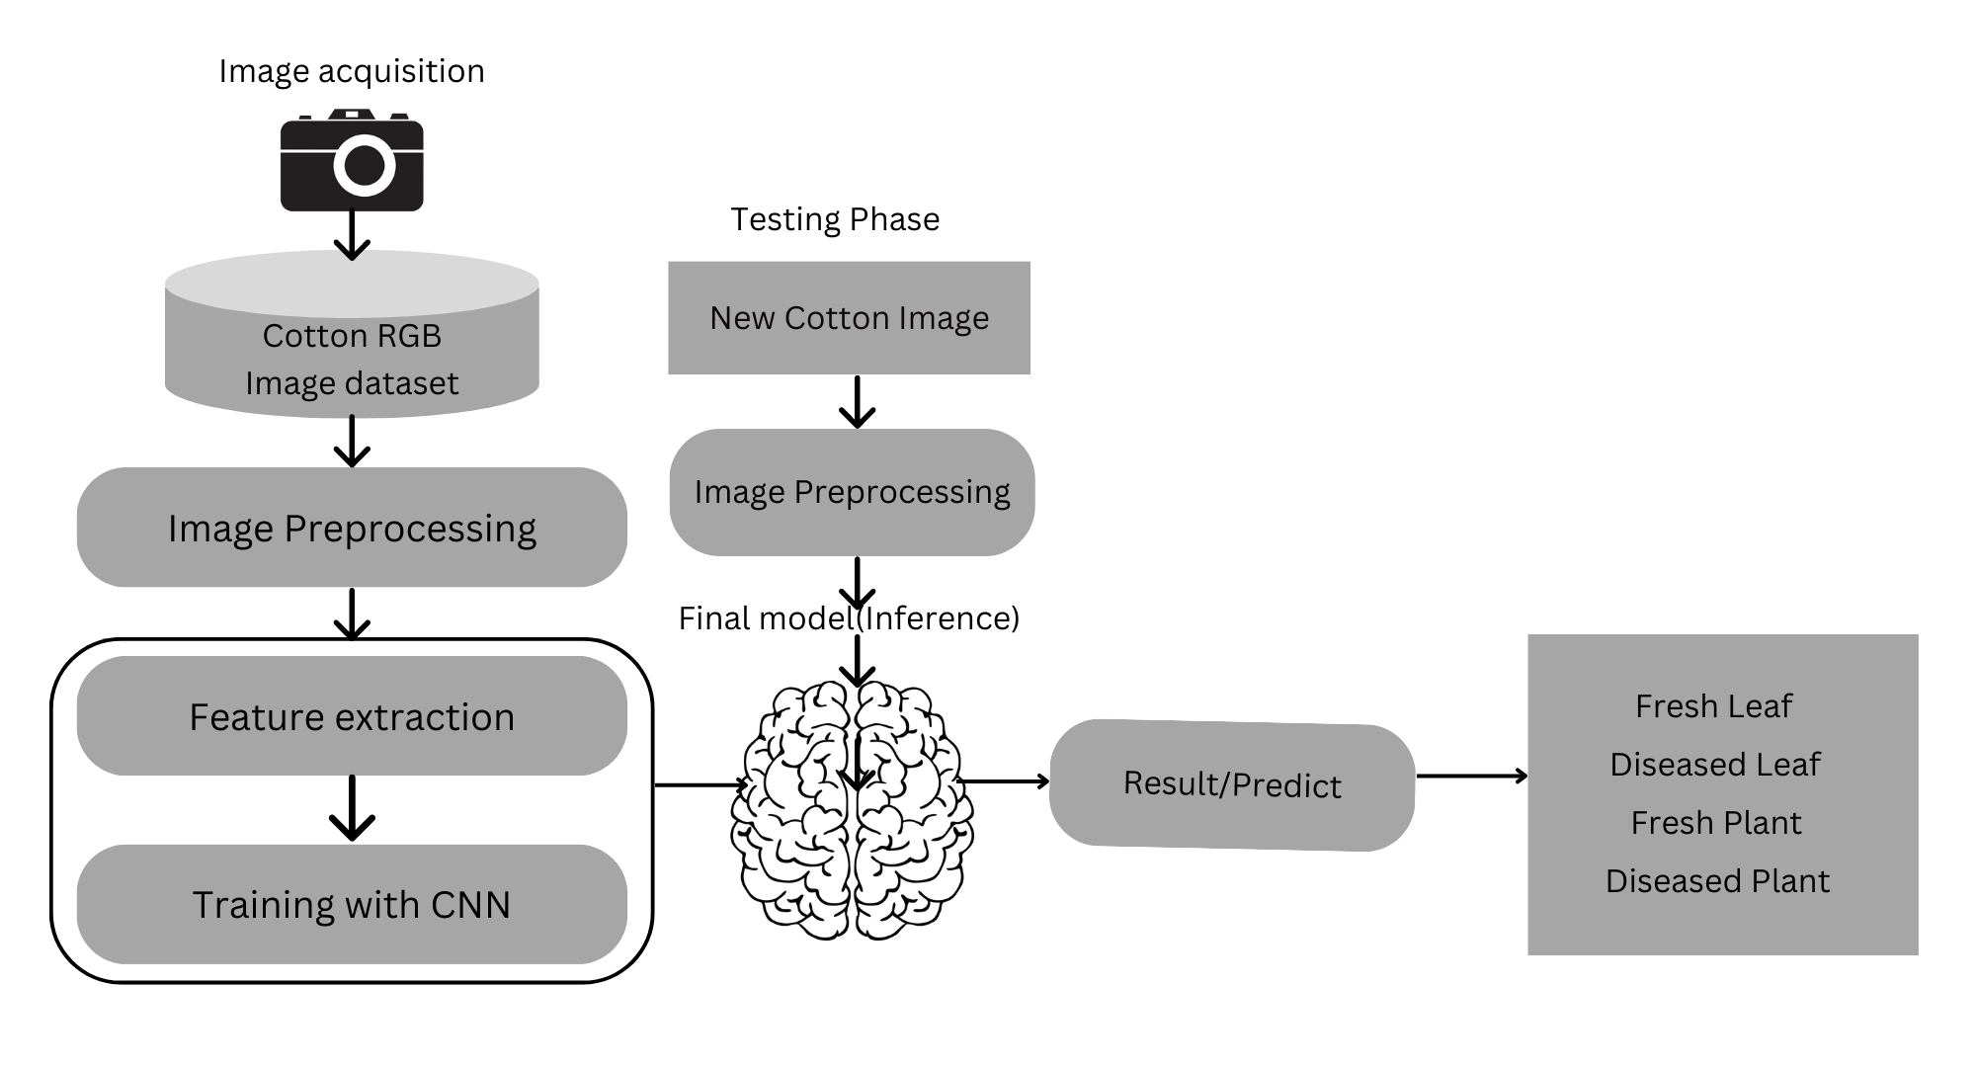
Preprocessing and Augmenting the Cotton Plant and Leaf Image Dataset
Prepare the cotton plant and leaf image dataset
Dataset labeled as fresh or diseased
Apply data augmentation techniques
Preprocess and augment cotton plant and leaf image dataset
Generate enhanced training data using data augmentation techniques
Use Anaconda Environment and Jupyter Notebook for model building
Train a CNN model using transfer learning with ResNet152V2
Utilize transfer learning with ResNet152V2 pre-trained model
Photo by Pexels

Slide 10
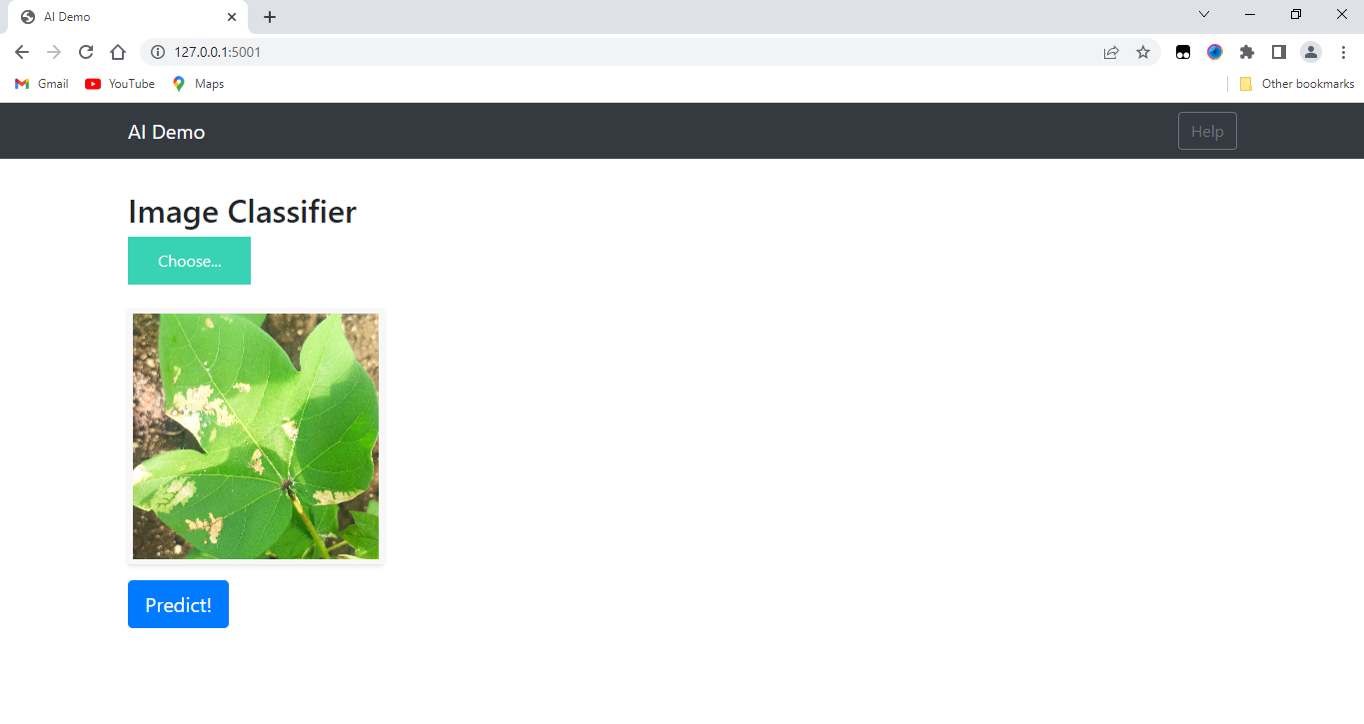
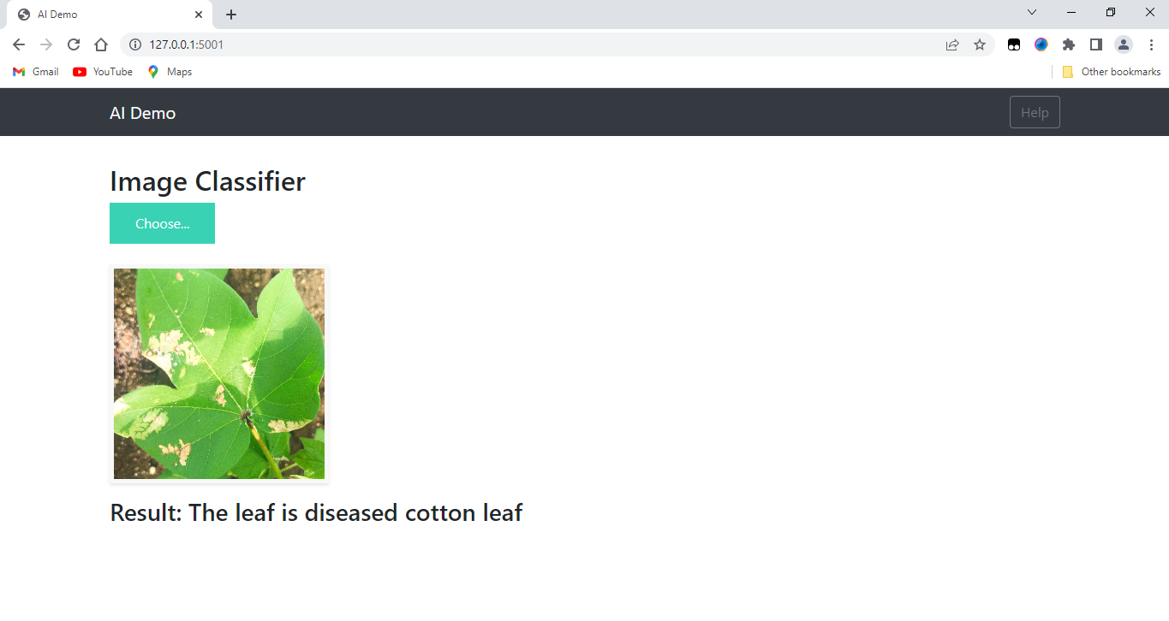
Building a Web Application with Flask
Create a user-friendly interface for the model, which Provide a user-friendly interface for model
Develop web applications using the Flask Python framework
Use Spyder as an IDE for running the Flask web application
Host the web application on a WSGI server
Allow users to upload images of cotton plants for prediction
Provide functionality to upload images
Ensure scalability and reliability
Photo by Pexels

Slide 11
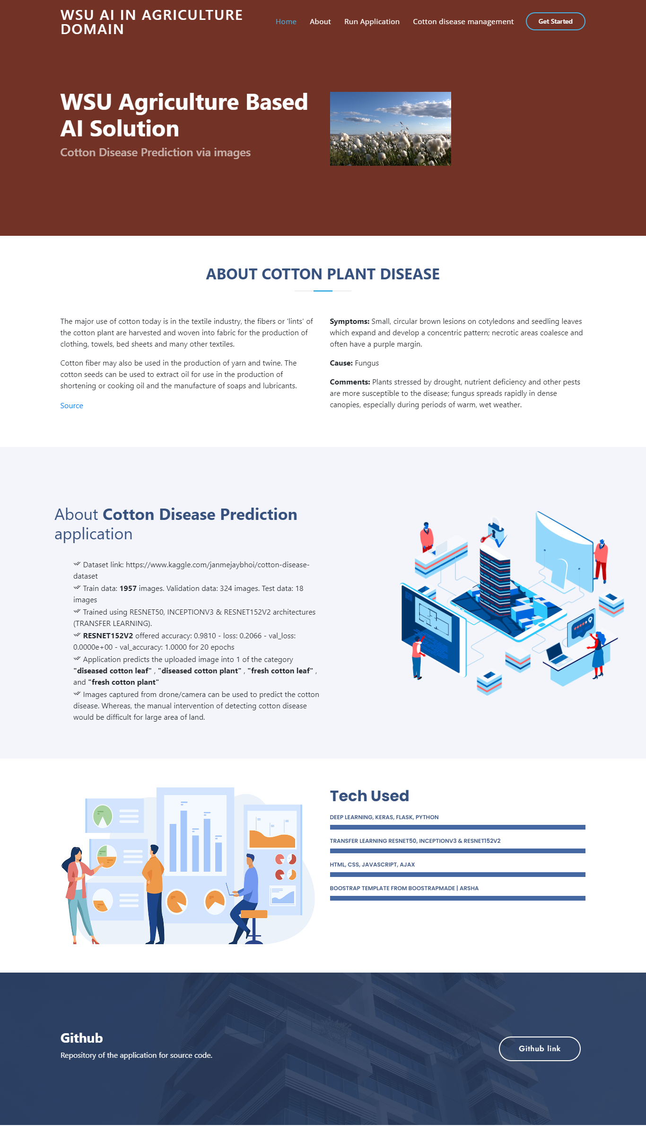
Developing an Interactive Web Page with Bootstrap
Utilize HTML, CSS, and JavaScript for interactive and visually appealing design.
Leverage the power of the Bootstrap framework by Incorporating the Bootstrap framework for pre-built components, styles and responsive layout
Integrated it with the previous solution web application allowing it to handle user requests and communicate with the prediction model that uses the Flask framework for server-side implementation
Develop an intuitive interface that allows users to upload images and receive predictions.
Photo by Pexels

Slide 12
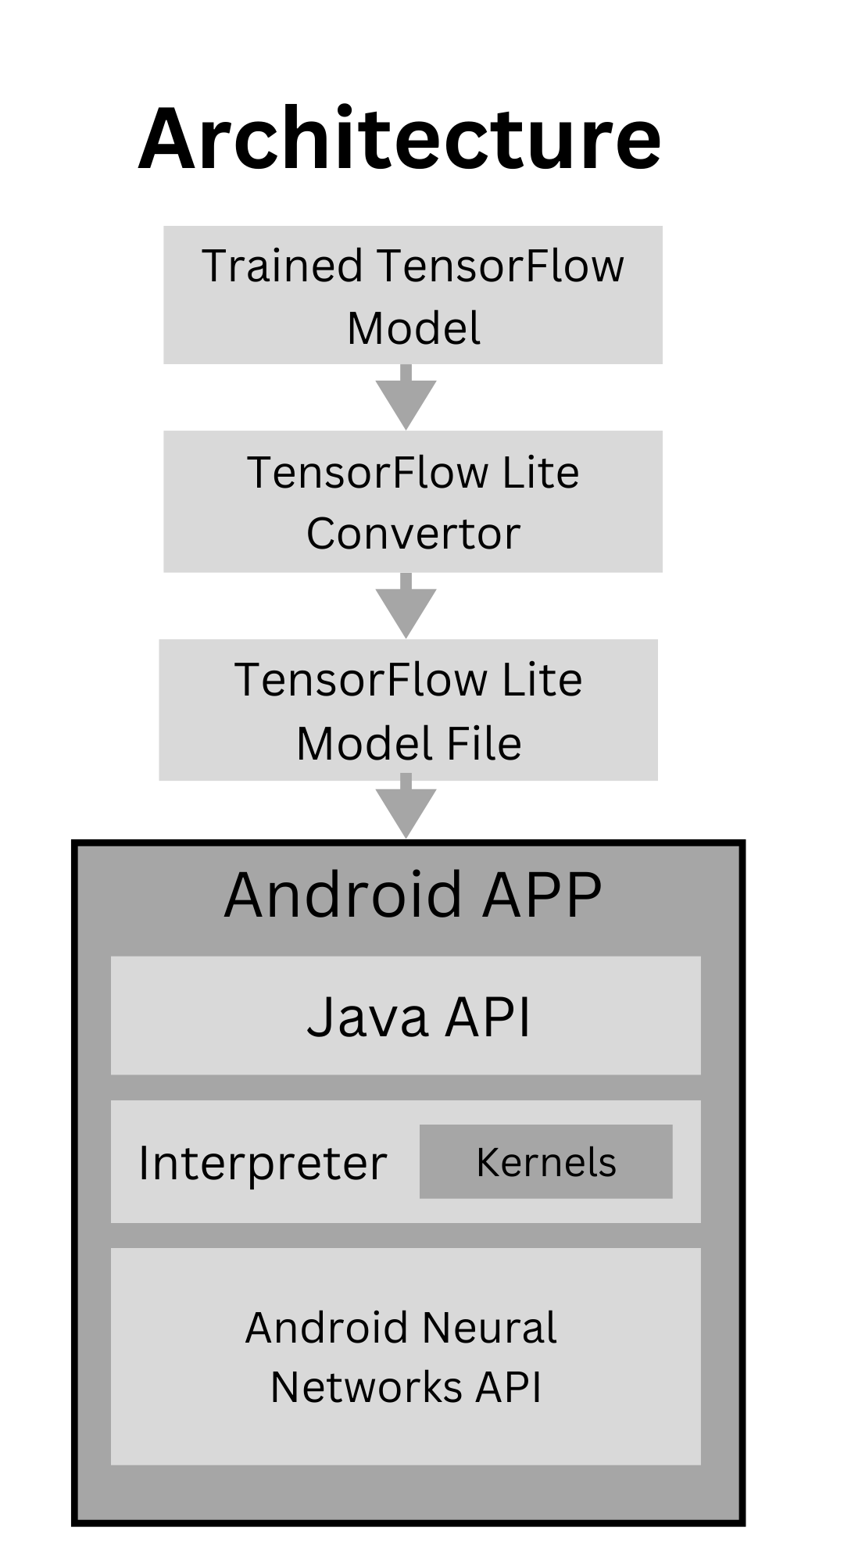
Mobile Android Application Integration with TensorFlow Lite
Convert the trained model to TensorFlow Lite format for easy deployment on Android Application mobile devices by Reducing the model size and increasing inference speed.
Develop an Android app using Java and Android Studio IDE.
Leverage or Utilize the Android Camera API for seamless image capture.
Integrate the TensorFlow Lite model using the TensorFlow Lite Android library.
Enable users to capture images and obtain predictions on the go.
Photo by Pexels

Slide 13
Results and Discussion
Home: Landing page of the website.
About: Overview of the AI project in agriculture, focusing on cotton disease prediction.
Run Application: Access and run the cotton disease prediction app.
Cotton Plant Disease Management: Advice and practices for controlling cotton plant diseases.
Symptoms and Cause: Specific cotton plant disease symptoms and fungal cause.
Application details: Dataset, training, architectures, and prediction categories.
Github: Link to the application's repository for source code access.
Photo by Pexels

Slide 14
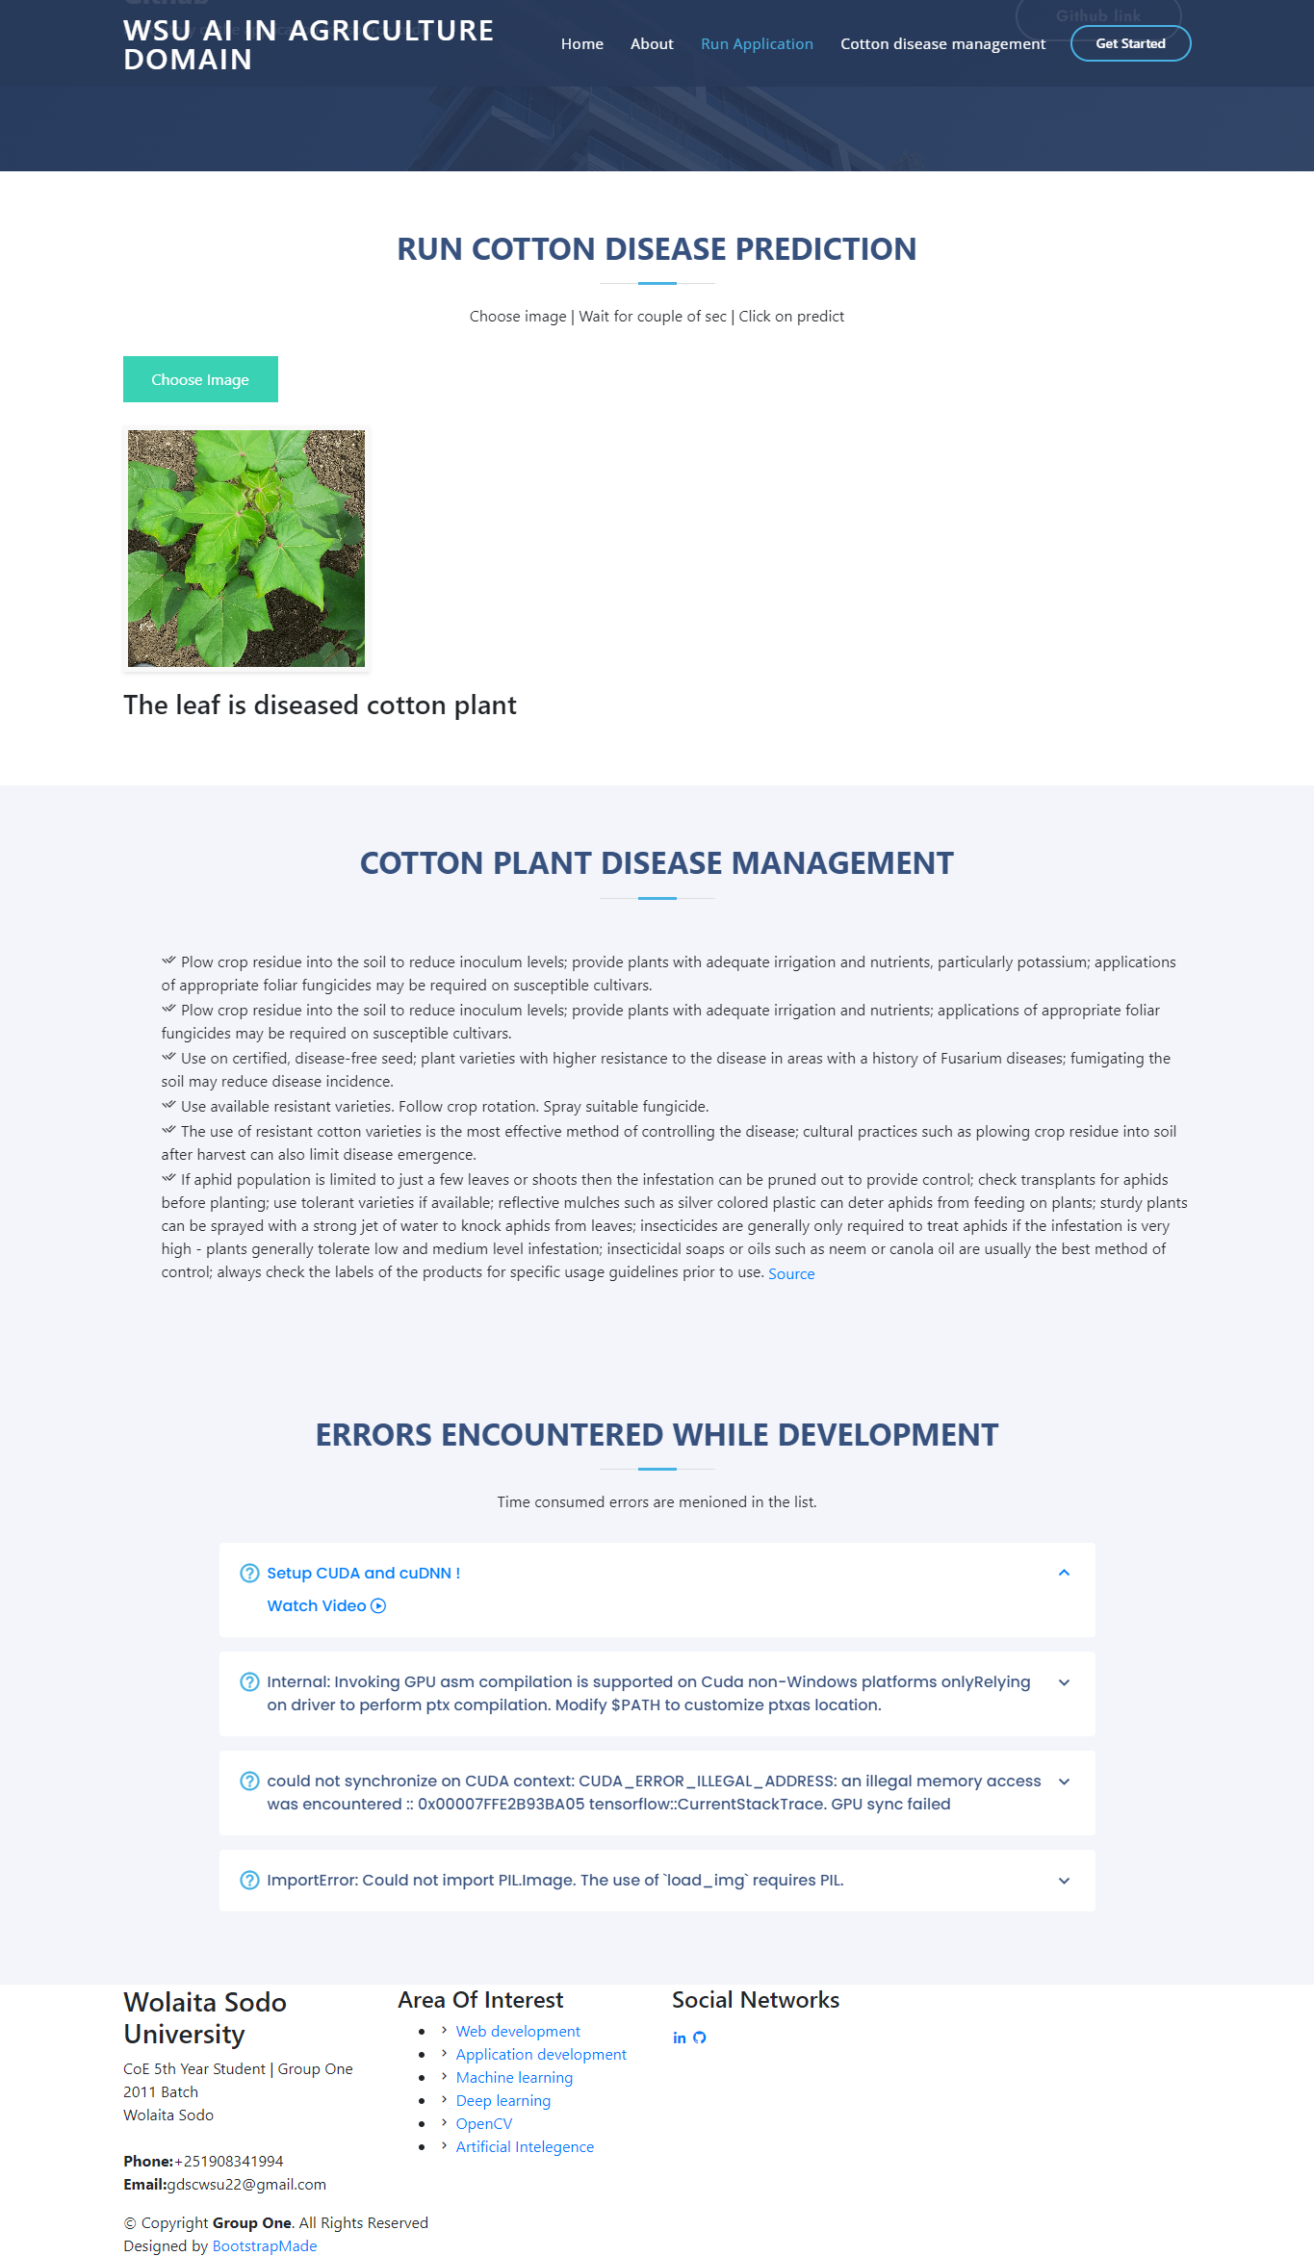
Results and Discussion
Images captured from drones/cameras: Utilizing aerial images for disease detection.
Technologies used: Deep learning, Keras, Flask, Python, RESNET50, INCEPTIONV3, RESNET152V2, HTML, CSS, JavaScript, AJAX, Bootstrap.
Run Cotton Disease Prediction: Action button to choose an image and predict the category.
Area of Interest: Mentioned areas of interest include web development, application development, machine learning, deep learning, OpenCV, and artificial intelligence.
Social Networks: Information about the university and contact details for the project group.
Copyright: Credits the design to BootstrapMade.
Photo by Pexels

Slide 15
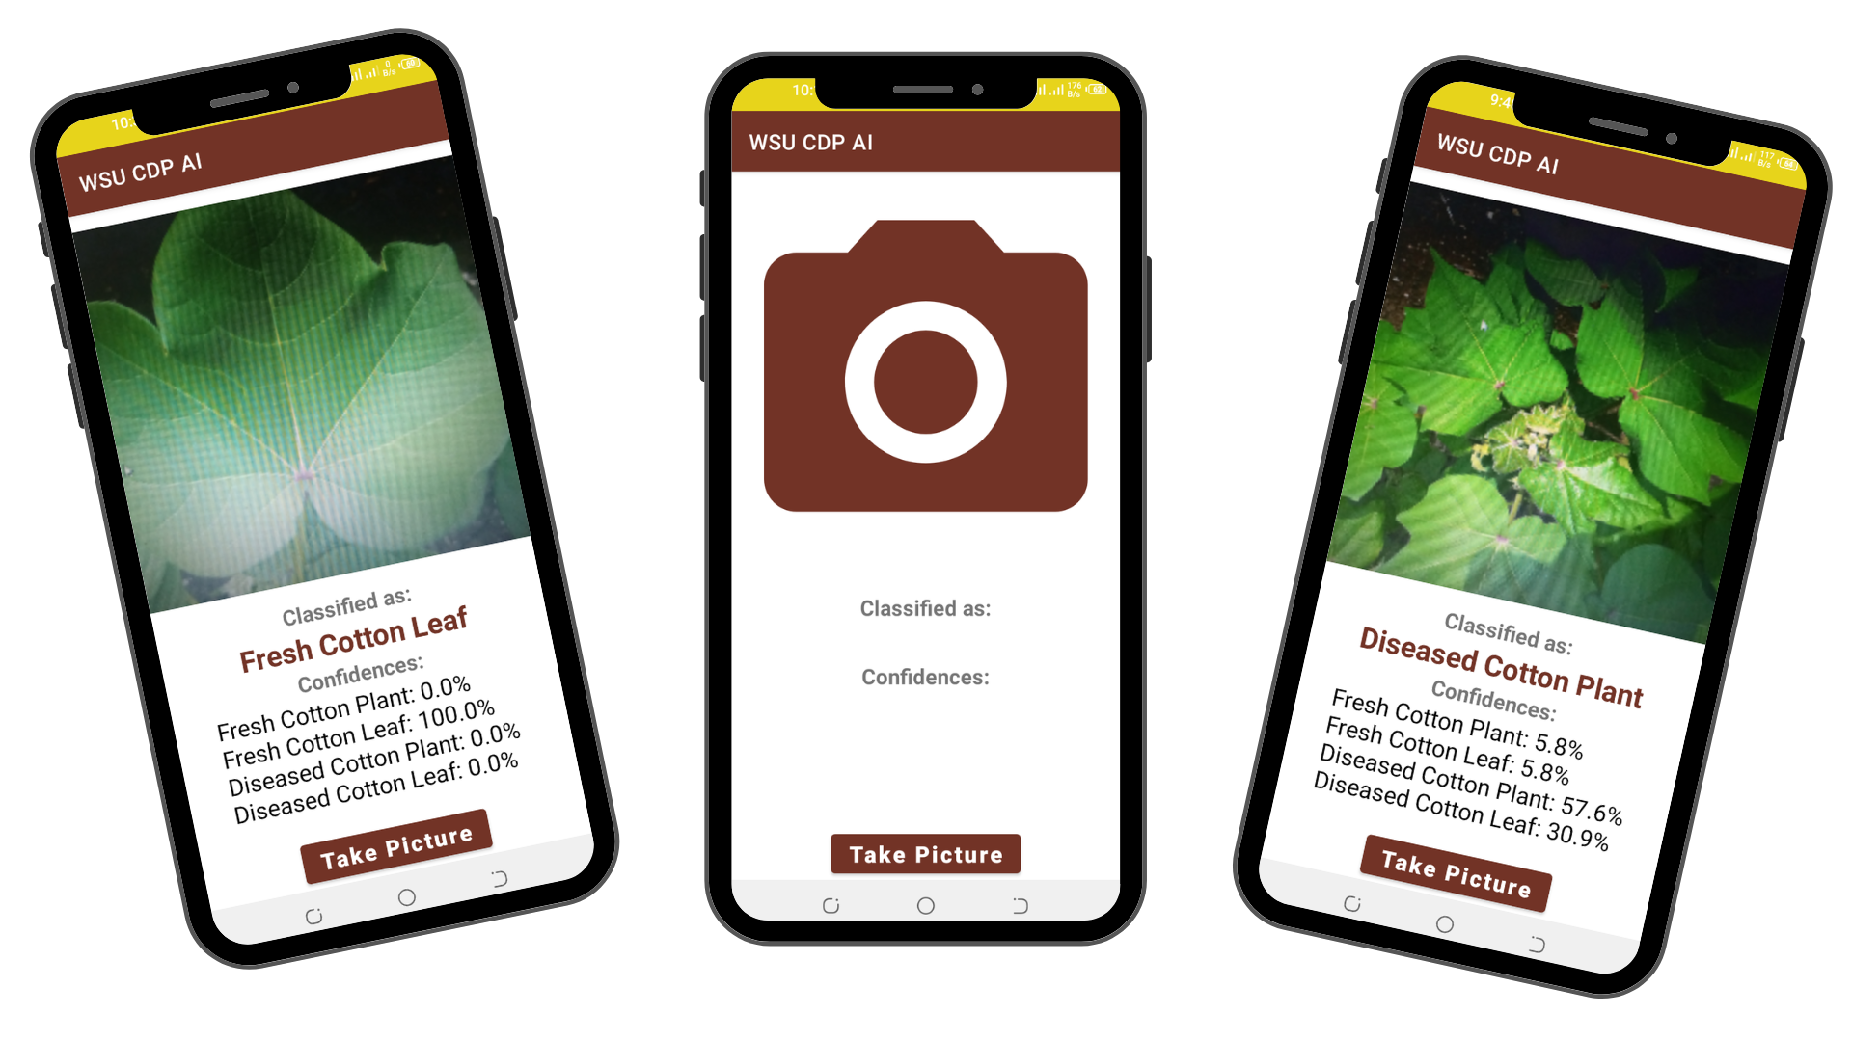
Results and Discussion
WSU CDP AI Android app: Captures cotton plant images and predicts diseases on mobile devices.
Processes images with a trained deep learning model via TensorFlow Lite.
Classifies images into Fresh Cotton Plant, Fresh Cotton Leaf, Diseased Cotton Plant, or Diseased Cotton Leaf.
Provides confidence scores for prediction reliability.
"Take Picture" button for quick image upload and analysis.
14

Slide 16
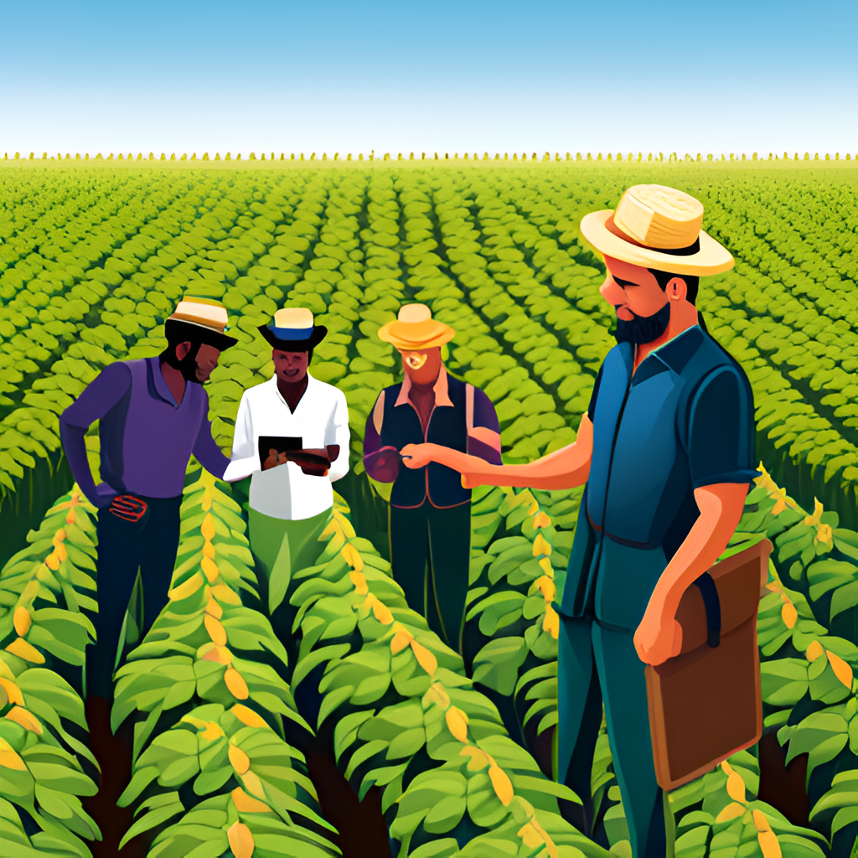
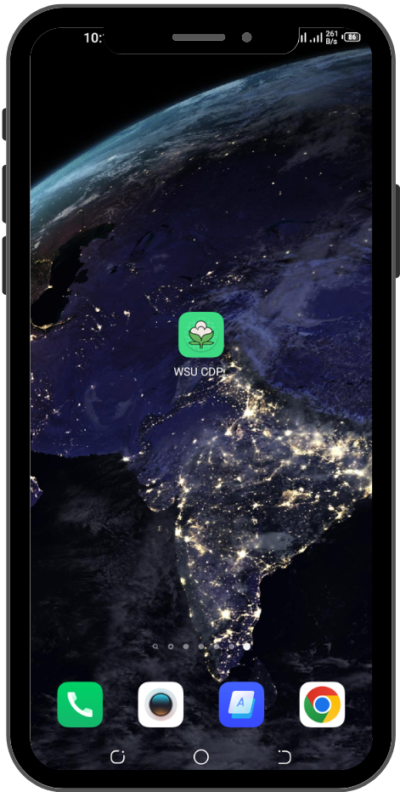
The Android Application
Will allow farmers to receive real-time disease predictions and make informed decisions while out in the field.
With this mobile integration, farmers can quickly and easily access information about their crops and take action to prevent disease outbreaks. This has the potential to significantly improve the efficiency and effectiveness of cotton farming.
Photo by Pexels

Slide 17
Testing Functionality and Accuracy
Image | Actual Disease Category | Predicted Disease Category | Accuracy
Image 1 | Diseased cotton leaf | Diseased cotton leaf | ✓
Image 2 | Fresh cotton plant | Fresh cotton plant | ✓
Image 3 | Diseased cotton plant | Diseased cotton plant | ✓
Image 4 | Fresh cotton leaf | Fresh cotton leaf | ✓
Image 5 | Diseased cotton leaf | Diseased cotton leaf | ✓
Image 6 | Fresh cotton plant | Fresh cotton plant | ✓
Image 7 | Diseased cotton plant | Diseased cotton plant | ✓
Image 8 | Fresh cotton leaf | Fresh cotton leaf | ✓
Image 9 | Diseased cotton leaf | Fresh cotton leaf | ✗
Image 10 | Fresh cotton plant | Fresh cotton plant | ✓
Conduct thorough testing on the web page and Android app.
Simulate user interactions by uploading and verify image predictions on the web page
Capture images of cotton plants on the Android app.
Thorough testing conducted on both platforms, Compare the app's predictions to ground truth to evaluate performance and accuracy.
Verify predictions align with the actual disease status of plants.
Evaluate app performance and accuracy by comparing predictions with ground truth
Photo by Pexels

Slide 18
Testing and Evaluation
Ensure functionality and accuracy of web page and Android app
Simulate user interactions and verify predictions
Thorough testing conducted on both platforms
Ground truth used to evaluate performance and accuracy
Potential of IT-based solutions in the field of agriculture
System detects cotton diseases with high accuracy
Promising results that can benefit farmers and agricultural professionals
Photo by Pexels

Slide 19
Limitations of the Solution
It is important to note that the proposed solution is specifically designed for the identification and prediction of diseases in cotton plants and leaves. It may not be able to accurately identify diseases or provide predictions for images of plants other than cotton, the scope of this study is limited to cotton plants and leaves and may not be applicable to other crops.
Dataset Bias
Sensitivity to Environmental Factors
Limited Disease Coverage
Hardware Requirements
User-Dependent Image Quality
Continuous Model Updates
18

Slide 20
Conclusion
The Cotton Disease Prediction Deep Learning system provides a valuable solution for accurately identifying and managing diseases in cotton plants. Its successful implementation demonstrates the effectiveness of deep learning and transfer learning in the agricultural domain.
The integrated web application, coupled with an informative web page and Android application offers practical tools for farmers, empowering them to make informed decisions and proactively manage diseases in their crops.
The system's potential extends beyond the cotton industry, highlighting the broader applications of deep learning techniques in solving complex problems across various domains.
19

Slide 21
Future Directions
Diverse Training Data
Treatment Suggestions
Integration of Satellite Imagery
Multi-modal Data Integration
Collaboration with Domain Experts
Handling Non-Cotton Images
Advanced Techniques for Adaptability
User Interface and Usability
20

